Slide 1



Retrieval-augmented generation (RAG)
In the sphere of artificial intelligence, the RAG approach stands out as a powerful technique, combining the precision of information retrieval with the sophistication of text generation. This synergy leads to a suite of unique capabilities enabling RAG-powered applications to offer accurate, contextually relevant, and dynamic responses
14/12/2023

Slide 2
Agenda
Compliance checks: Automatic validations
Process Flow
Document splitting (chunking)
Embeddings
Vector Database
Document Retrieval
Answer Generation

Slide 3
Compliance checks: Automatic validations
RAG's fact verification and compliance validation functionalities make it a valuable asset in the legal and compliance domains.
When dealing with legal documents or regulatory requirements, RAG can cross-reference information from trusted sources, contributing to the creation of accurate legal documents.
Its fact-checking ability ensures that the information presented aligns with legal standards, minimizing the risk of errors and enhancing overall compliance.

Slide 4
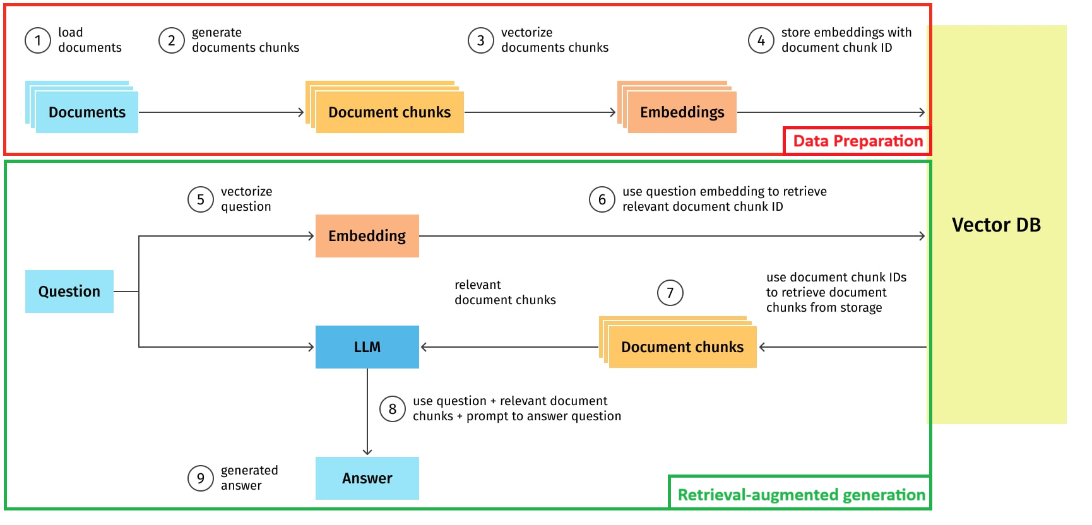
Process Flow

Slide 5
Document splitting (chunking)
The core activity in this stage involves segmenting these texts into manageable chunks, a procedure also known as text splitting or chunking. This becomes essential when handling extensive documents. Given the token limit imposed by many LLMs (like GPT-3's approximate limit of 2048 tokens), and considering the potential size of documents, text splitting becomes indispensable.
The chosen method for text splitting primarily depends on the data's unique nature and requirements.

Slide 6
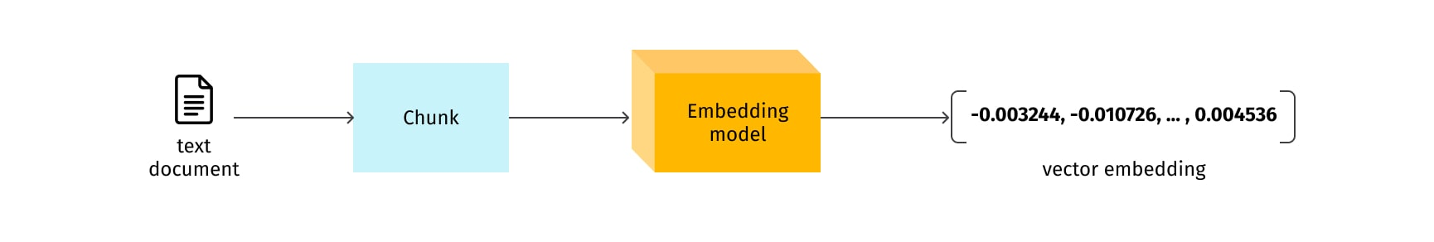
Embeddings
Embedding is a numerical representation of content in a form that machines can process and understand.
The essence of the process is to convert an object, such as an image or text, into a vector that encapsulates its semantic content while discarding irrelevant details as much as possible.
An embedding takes a piece of content, like a word, sentence, or image, and maps it into a multi-dimensional vector space.

Slide 7

Embedding Visualization
The visualization of text embeddings can provide intuitive insight into how this works. In a two- or three-dimensional representation of the embedding space, similar words or sentences cluster together, indicating their semantic proximity. For example, embeddings of 'dog', 'cat', 'pet' might be closer to each other than to the embedding of 'car’

Slide 8
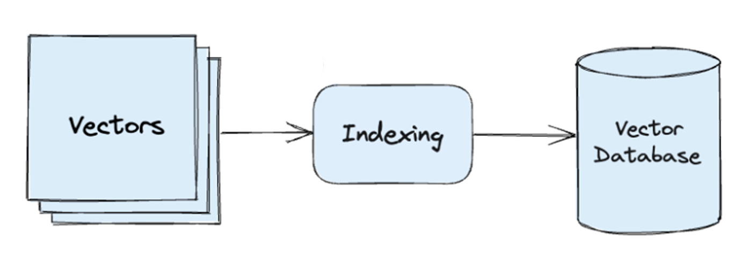
What is a Vector Database?
A vector database is a type of database that indexes and stores vector embeddings for fast retrieval and similarity search, with capabilities like CRUD operations, metadata filtering, and horizontal scaling.
Indexing: The vector database indexes vectors using an algorithm such as PQ, LSH, or HNSW. This step maps the vectors to a data structure that will enable faster searching.

Slide 9
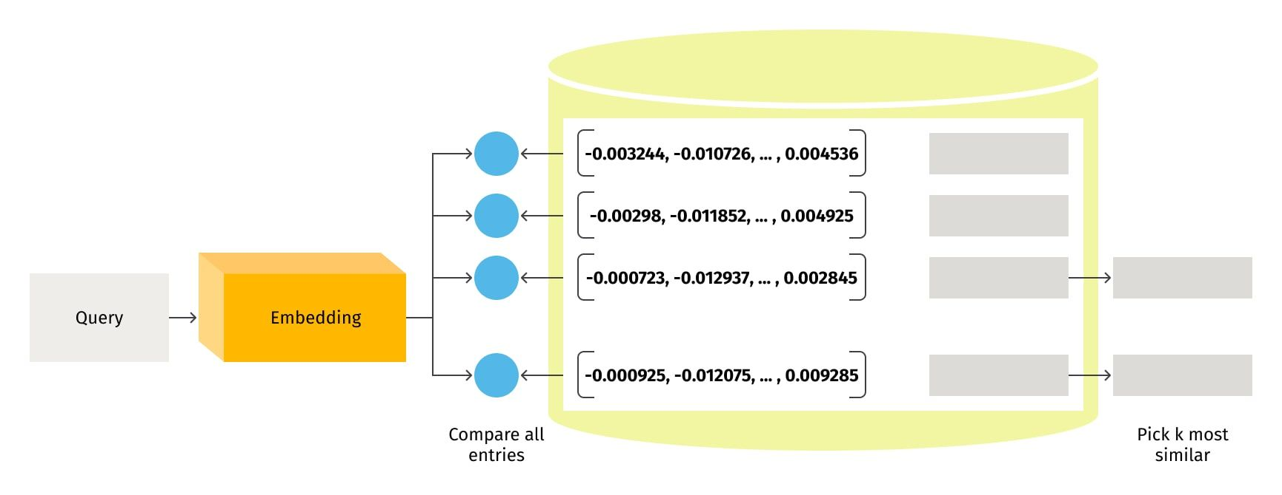
Document Retrieval
The retrieval process is an integral part of any information retrieval system, such as the one used for document searching or question answering. The retrieval process starts when a query is received, and it is transformed into a vector representation using the same embedding model used for document indexing. This results in a semantically meaningful representation of the user's question which can subsequently be compared with the chunk vectors of documents stored in the index (vector db).
The primary objective of the retrieval is to return relevant chunks of documents that correspond to the received query.

Slide 10
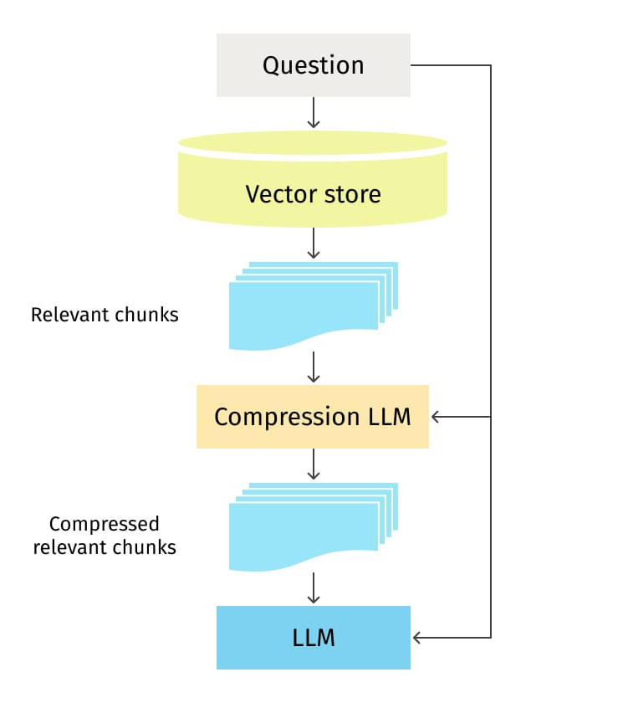
Answer Generation
In the final phase, the document chunks identified as relevant are used alongside the user query to generate a context and prompt for the LLM.
The prompt, which is essentially a carefully constructed question or statement, guides the LLM in generating a response that is both relevant and insightful.

